Slide 1
Funding opportunities

Slide 2
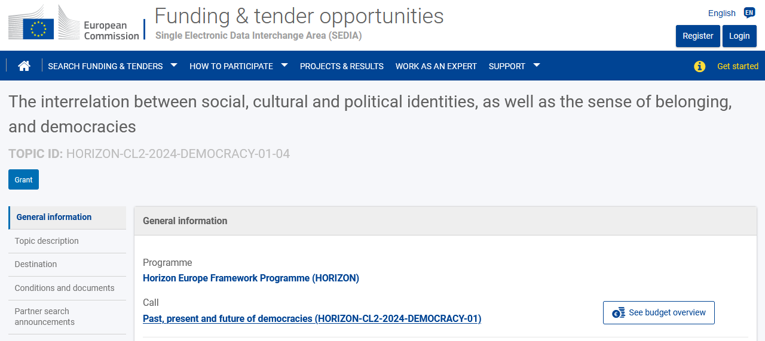

Slide 3
Open Research Area (ORA) for the social sciences
Must involve researchers from ≥ Canada, France, Germany, UK (+ Japan). Other international researchers can be included through inclusion on projects funded by ESRC (UK) and SSHC (Canada); not sure about Fra/Ger.
Deadline: 14 Nov 2023. 2-3 year projects.
Applicants can only be involved in one project.
Budget must respect funding limits (and procedures) set by each of the four national funding agencies (eg. ESRC: £200-600k, at 80% FeC).
Single proposal, to SSHC (+ applications to national funding agencies).
Peer review; responses to reviews (Mar-Apr 2024); commissioning panel (Jun 2024); decision (Sept 2024). Start: 1 Oct 2024 – 31 Mar 2025.

Slide 4
Trans-Atlantic Partnership (T-AP) call on Democracy, Governance and Trust
Focused on the challenges of (dis)trust and on policy interventions. Needs to involve working with stakeholders/community groups.
“These objectives aim to leverage expertise from SSH, and relevant related disciplines, to tackle prominent challenges facing societies today - making use of theoretical and empirical insights and recognizing the value of co-production and practice fostering initiatives and projects conducive to supporting democratic experimentations and experiences, governance improvements and trust.”
Call focuses on nine cross-cutting themes: 1. Concepts, understandings, and models of democracy, governance and trust 2. Education 3. Media, information, and communication 4. Economies and economic systems 5. Identities, discrimination, marginalization, and inequalities 6. Ecosystems and environments 7. Epistemologies, knowledge, and expertise 8. History and culture 9. Power, authority, and conflict.

Slide 5
Trans-Atlantic Partnership (T-AP) call on Democracy, Governance and Trust
Projects must involve investigators from ≥3 countries from both sides of Atlantic. Funding agencies include: Brazil, Croatia, Poland and South Africa. Other international researchers can be included through inclusion on projects funded by national agencies.
Applicants can only be involved in one project.
Deadlines: notice of intent to submit (15 Sept 2023), deadline (6 Nov 2023). 2-3 year projects.
Max funding limits of national agencies (eg. ESRC: £300-400k).
Peer review; expert panel evaluations (Mar-Jun 2024); decision (Jul-Aug 2024); project start: (Sept 2024).

Slide 6
HORIZON: Past, present and future of democracies (CL2-2024-DEMOCRACY-01)
Call opens: 3 Oct 2023; deadline: 7 Feb 2024
The interrelation between social, cultural and political identities, as well as the sense of belonging, and democracies (Democracy 04)
“proposals should help further investigate the way that democracy and its key tenets such as political representation, participation or trust are interrelated to social, cultural, and political identities”
The role and functioning of public administrations in democratic systems (Democracy 09)
“particular attention should be paid to the role and functioning of public institutions in democratic systems, their role in fostering democratic, economic and social stability, and in reforming public management and institutions in ways that enhance citizens’ trust in government and active participation in public affairs”
Future scenarios and young visions for European democracy 2040 (Democracy 11)
“investigate the future of democracy and its instruments, and will also explore the views of political institutions such as national parliaments and the European Institutions, and those of organised civil society actors as regards their visions for the future, emerging trends such as e.g. participatory and deliberative democracy models that better serve the public good, build trust between governments and citizens, and deepen democracy at large.”

