Slide 1
SPATIALITY AND ORAL SKILLS IN THE LANGUAGE SPEAKING CLASSROOM
SECL FORUM
SONIA FERNÁNDEZ PONTE
NATALIE WEISSENBOECK
LÉA QUINET

Slide 2
TODAY
Introduction
Room layouts and their impact on teaching and learning
Sitting v. Standing : 3 activities to enhance the acquisition of speaking skills
Conclusion

Slide 3
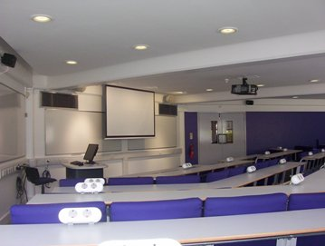
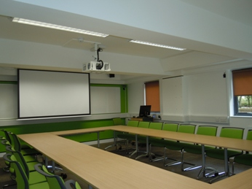
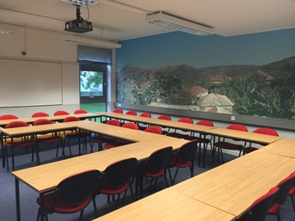
ROOM LAYOUT: the sitting plan
Rows
More formal
Individualistic approach
U shape
More aware of their fellow students
Easier to move around
Double U shape
Decreases awareness of other students
COLT2
GS3
CRNWsr6

Slide 4
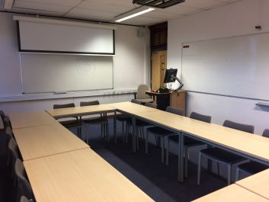
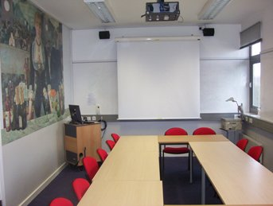
WHITEBOARDS
Around the room is practical for group work.
BUT it also means it’s in the students’ backs sometimes.
CNWsr1
CNWsr11

Slide 5
SITTING v. STANDING

Slide 6
ACTIVITY 1: Spelling competition
A1-A2 students of Spanish: good for revising the alphabet.
Non-talkative behaviour of first and second year students challenge the teacher.
What do we need? - Whiteboard and markers.
List of words
Steps to follow:
Divide the class in groups.
One person of each group goes into the whiteboard. The remaining members of the team stand up opposite to the whiteboard.
Students start spelling the words from the list. When a word is spelled completely, the person in the whiteboard goes back to the group and a new member goes out.
Aim: to be the first team completing the list.

Slide 7
ACTIVITY 1: Spelling competition (II)
What is the interesting thing here?
All teams are playing at the same time:
friendly competitiveness.
Awareness of own weakness and strengths. Boost of confidence.
All the teams are standing up:
Need of great classroom layout or spacious room to move freely and safely.
Why this game?
It is empiric.
Students were reticent, but ended up enjoying it.
It created a relaxed atmosphere that favored speaking out, bonding with classmates and having fun while revising Spanish.
Use of the classroom space for a different learning strategy.

Slide 8
ACTIVITY 2: a game of pronunciation
Rules: all the students stand and, each in turn, they read a word from a list. If they succeed they stay up, if they fail they sit down.
Positive atmosphere
Increases the students’ attention
Calls on kinesthetic memory
Aftermath: students seem to remember rules better than if they had simply sat throughout the class.
Limits: only for pronunciation or vocabulary exercises.

Slide 9
ACTIVITY 3a: Mix and mingle
Activity: students walk around and change speaking partners
Sample topics: going shopping, finding flats, job interview…
Benefits:
Concentration, attention, authenticity → motivation, variety of people (lang. levels, ideas…) student centred, actual speaking time
Challenges:
Space required, time to find partners, chaos, fluency vs. accuracy

Slide 10
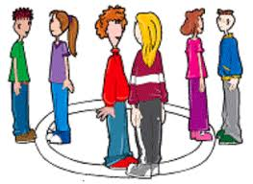
ACTIVITY 3b: Inner + outer circle
Activity: student A from inner circle talks to student B from outer circle, after a set time either the inner or the outer circle moves on → new partners
Additional benefits to “Mix and mingle”:
Limited period of time → less chaotic, more controlled setting
No time lost for students to find new partners

Slide 11
CONCLUSION
Receptive students
Positive atmosphere: Free from fear of committing mistakes or speaking out loud.
Varying sensorial memory
Perfect combination with authentic speaking activities, beneficial mix of students

Slide 12
THANK YOU!!
DANKESCHÖN!
¡GRACIAS!
MERCI!

