Slide 1
Promoting Communication in Mixed-Ability Classrooms: a Ludological Approach
Maya Coianiz, Patricia Díaz Muñoz, Caroline Personne, Laura Stecca

Slide 2
Different students
1) Students whose mother tongue is not English
2) Students whose mother tongue is English
3) Bilingual students

Slide 3
"The ludological approach is a teaching strategy aimed at providing the students with a positive learning environment. The learner is the protagonist of his own congnitive process, throughout cooperation and positive competition with his peers."
[speakers' translation] M. A. Lombardo, 2006

Slide 5
How to deal with mixed ability classes
Main difficulties:
Advanced students may find the lessons boring and unproductive
Weaker students may get discouraged and intimidated

Slide 6
How to deal with mixed ability classes
Adapt materials to students' necessities
Pay special attention to weaker students Assistants
Group the students and assign them different roles
Share ideas
Help each other
Cooperative games

Slide 7
In-class experimentation: Italian as a FL
Stage 1: INDIVIDUAL
find as many words as possible using the letters available.
Given the word
"ELICOTTERO"
Stage 2: IN PAIRS
compare the two lists and make one;
find other words.
Stage 3: IN GROUPS
compare the lists and make one;
find other words;
get the meaning of every word on the list clear to everyone in the group;
create a story using the words found.

Slide 8
Further rules: enhance learners' motivation
Each task is completed within a 3-minute time
Each word found gives the team points:
< 4 letters: 1 point scored
> 4 letters: 5 points scored
anagram of the given word: 20 points scored
Being able to define a word: 5 points
Not being able to define a word: -5 points
The funniest story gets 100 points

Slide 9
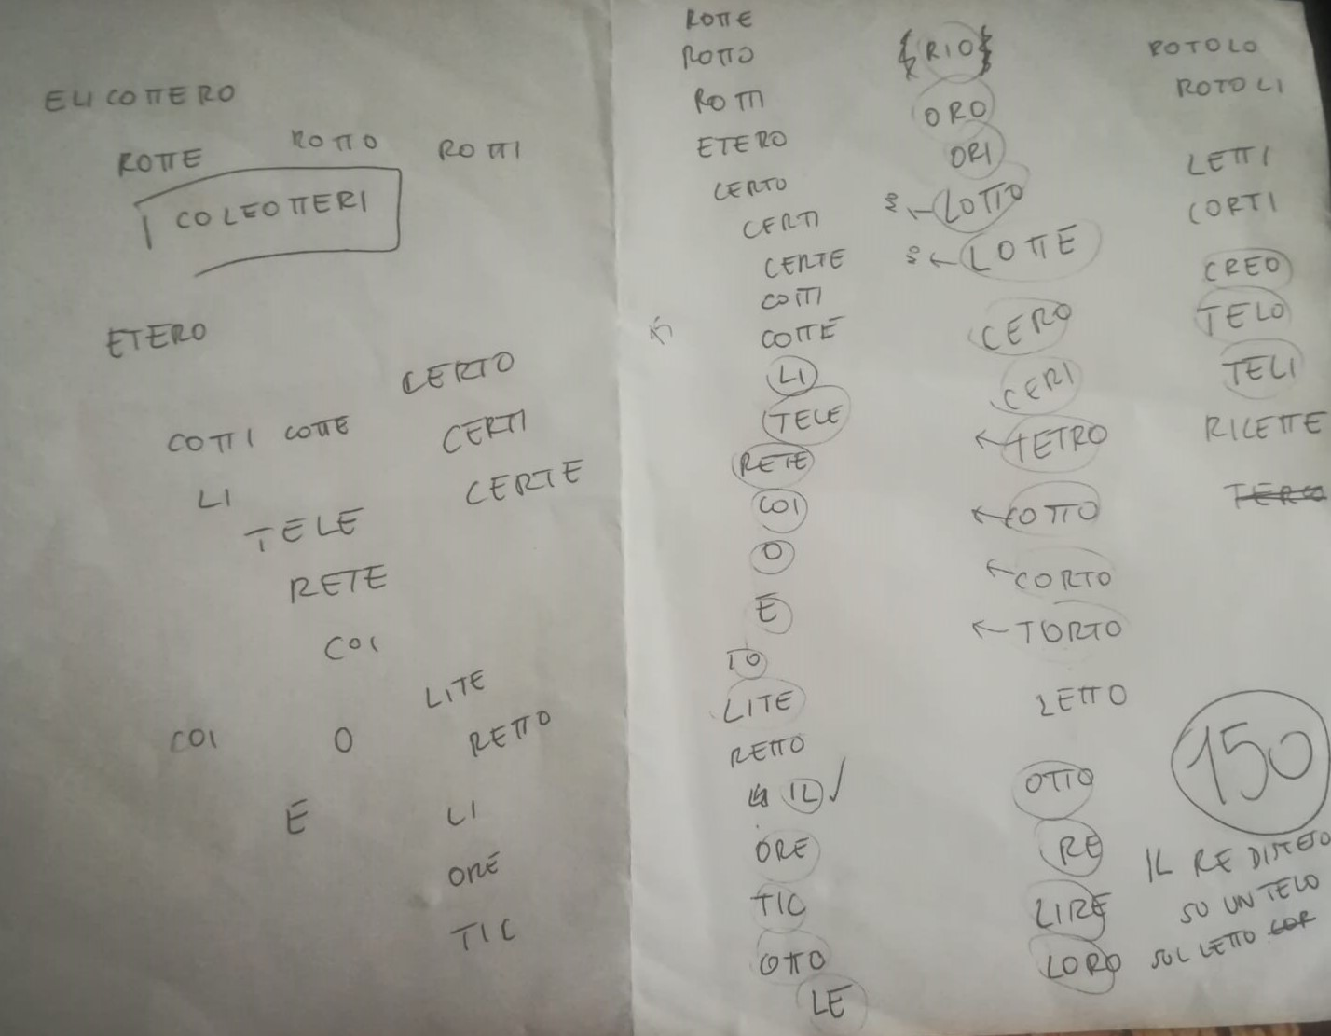
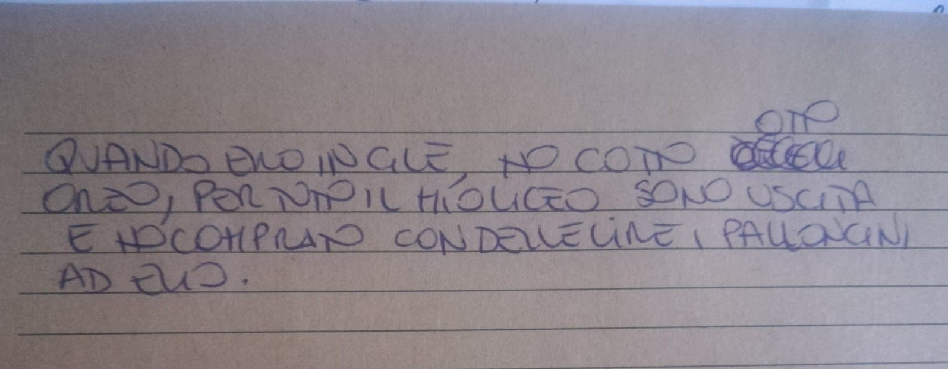

Slide 10
Outcomes of the activity
ENGAGING ADVANCED STUDENTS
Advanced students felt challenged at all stages:
They actively engaged by writing down the list for the pair and then for the group
They felt responsible to come up with the anagram of the given word
They had to be able to explain the meaning of all the words to the components of the group
They took a leading role in the combination of the words to invent the story

Slide 11
Outcomes of the activity
ENGAGING THE WEAKER STUDENTS
The students felt involved at all stages:
Everybody at the beginning had to work separately (independent thinking) without feeling the pressure of the more advanced peers
The difficulty of one of the tasks (to be able to explain to the teacher the meaning of the words):
- increases collaboration with advanced students
- increases motivation for the activity, as personal agency is involved

Slide 12
Outcomes of the activity
BENEFITS FOR THE GROUP
The score system and the final prize increase competition and engagement within the groups
New vocabulary available for everybody (oral and written practice)
Constant communication in the FL between the members of the group
Students are more comfortable in working with each other (lower level students see the others as a resource rather than as a threat)

Slide 13
Bibliography
Caon F., La CAD: Fondamenti teorici e dimensione operativa , Educazione linguistica nella Classe ad Abilità Differenziate, Torino, Bonacci/Loescher, 2016;
Caon F., Tonioli V., La sfida delle classi ad abilità linguistiche differenziate (CAD) in Italia e in Europa, in "Le lingue in Italia, le lingue in Europa: dove siamo, dove andiamo" Melero Rodríguez C. A. (curator), Ca' Foscari editions, 2016;
Caon F. (curator),Educazione Linguistica nella classe ad abilità differenziate, Torino, Bonacci/Loescher, 2016;
Dörnyei Z., Motivation and Motivating in the Foreign Language Classroom, in "The Modern Language Journal", Vol. 78, Wiley (on behalf of the National Federation of Modern Language Teachers Associations), 1994;
Lombardi M. A., La didattica ludica nell'insegnamento linguistico, EL.LE, June 2006;
Tielmana K., den Brokb P., Bolhuisa S., Vallejoc B., Collaborative learning in multicultural classrooms: a case study of Dutch senior secondary vocational education, in "Journal of Vocational Education and Training" Vol. 64, No. 1, March 2012.

