Slide 1
How to deal with lack of confidence in speech?
Sara Campo Medina
Erica Morone
Aliénor Vauthey

Slide 2
Introduction:
Arnold (2006):
SLA is influenced by affective factors
Cognitive + affective = cannot be separated
Chemers et al. (2001):
(-/+) Self confidence = (-/+) expectations of success = (-/+) performance

Slide 3
Lack of confidence in speech in the L2 classroom:
Low self-confidence = low participation = less efficient learning
Classes are designed for extroverted people
“It is not that introverted people do not want to talk, rather than it is difficult for them”
(Burba, 2015)

Slide 4
Solutions: an outline:
Time and participation
Disembodiment: the role play
Defusing over-seriousness in the classroom

Slide 5
Give them time:
Participation = key to improve oral skills
60% did not participate in class because they were afraid to speak (Saito, 2007)
Preparation = participation
Flipped classroom
Presentations
Do not choose the first hand
Let them speak first

Slide 6
2. Role play: a way to forget yourself
Avoiding the feeling of self-consciousness: roleplay activities take pressure away from the students as they are asked to express somebody else’s opinion, thus not involving or exposing their own selves.
Lighter, less intimidating setting in the classroom: the attention is focused on the game, on the communication itself, in such a way that the students can set aside the worries connected with being in class as well as the pressure of performance.
Small group interaction: max. 3 people – co-teaching offering the chance to actively follow more groups at once and providing more support and inputs during the activity.

Slide 7
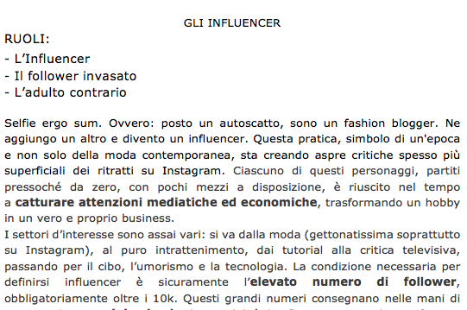
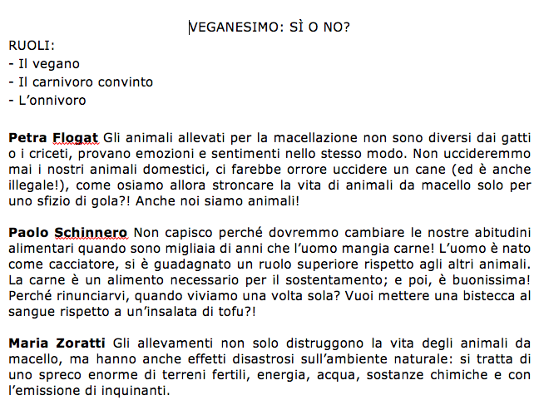
Examples of Role Play activities: “Gli influencer” and “Veganesimo: sì o no?”
“extreme” roles entailing a with a very defined point of view so that the students can have fun playing a caricature.
reading activity to be carried out before the role play, allowing the students to familiarise with the topic as well as providing a source of input during the conversation.

Slide 8
Role play: outcomes of the activity
All students, regardless their usual level of confidence, were actively engaged in the activity.
Feeling safe behind their role, even the shiest and less confident students effectively contributed to the conversation, speaking more than what they would normally do in other, more “exposing” kinds of activities.
The playful dimension of the activity managed to create a fun and enjoyable atmosphere in the classroom: the students got carried away with their discussion.
Notes:
do i need this?

Slide 9
3. A fun activity : the “what am I ?” post-it game
The rules : In pairs, each person secretly writes on a post-it the name of something that can be consumed (eg, food, clothing, object, etc.) and then sticks it to their classmate’s forehead. The goal of the game is to find what you are by asking questions that can only be answered by “yes” or “no”.
Ex: Am I edible? Am I green? Can you find me in a kitchen?
Oignon
Pantalon
Bougie

Slide 10
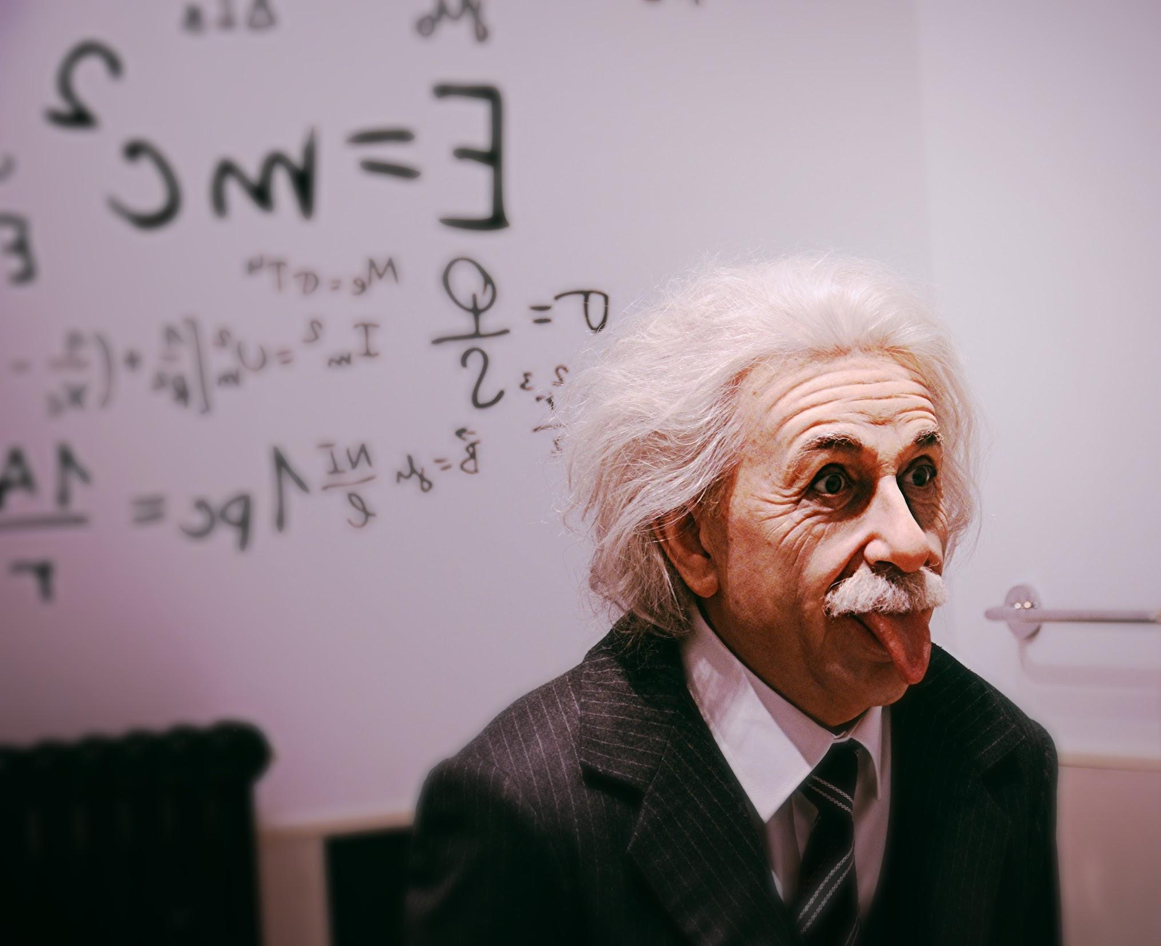
The personal anecdote: why being ashamed of your accent won’t get you anywhere
The fear and shame of having a bad accent is a prominent factor that prevents students from engaging confidently in speaking activities, thus it needs to be addressed.

Slide 11
References
Arnold, (2006) “Comment les facteurs affectifs influencent-ils l’apprentissage d’une langue étrangère?”, Études de linguistique appliquées, pp. 407-425.
Burba, K., (2015). Cómo mejorar las clases de idioma para los estudiantes introvertidos. (Thesis). California Polytechnic State University.
Chemers et al., (2001). Academic self-efficacy and first year college student performance and adjustment. Journal of Educational Psychology, 93(1), 55-56.
Pulford and al. 2017 “Do social comparisons in academic settings relate to gender and academic self-confidence?”, Social psychology of education, pp. 677-690.
Saito, A., (2007). Perfil de los Estudiantes Japoneses en el Español de España. Interlingüística, ISSN 1134-8941, nº 17, 2007, pp. 944-95.

Slide 12
How to deal with lack of confidence in speech?
Sara Campo Medina
Erica Morone
Aliénor Vauthey

